Slide 1


Slide 2


Slide 3


Slide 4
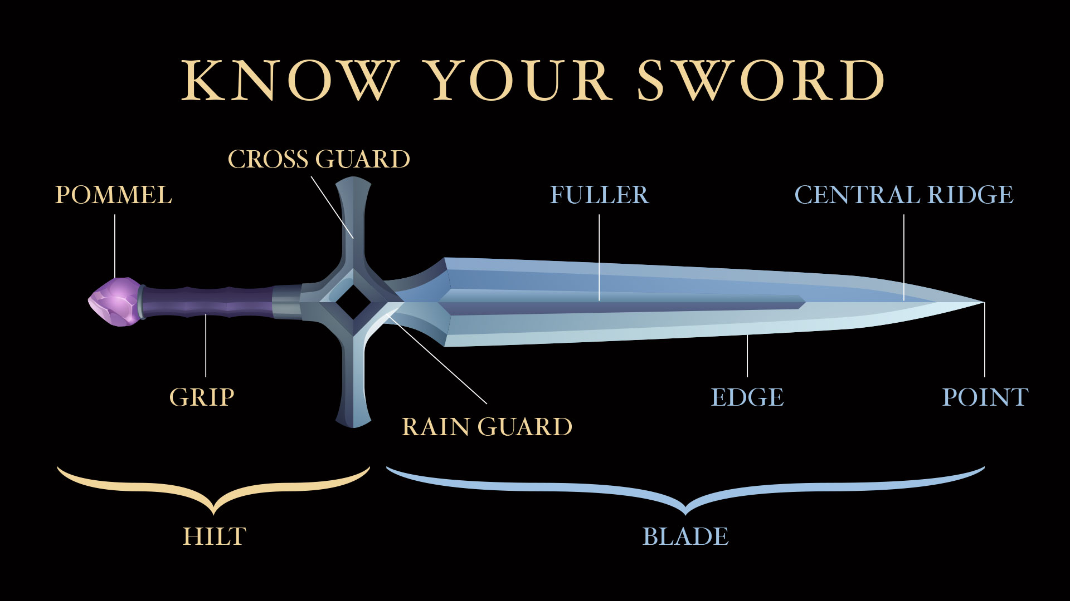

Slide 5


Slide 6


Slide 7


Slide 8


Slide 9


Slide 10


Slide 11


Slide 13
The additional slides below are
provided so the PowerPoint can be adapted to best fit your needs.

Slide 14


Slide 15


